Slide 1
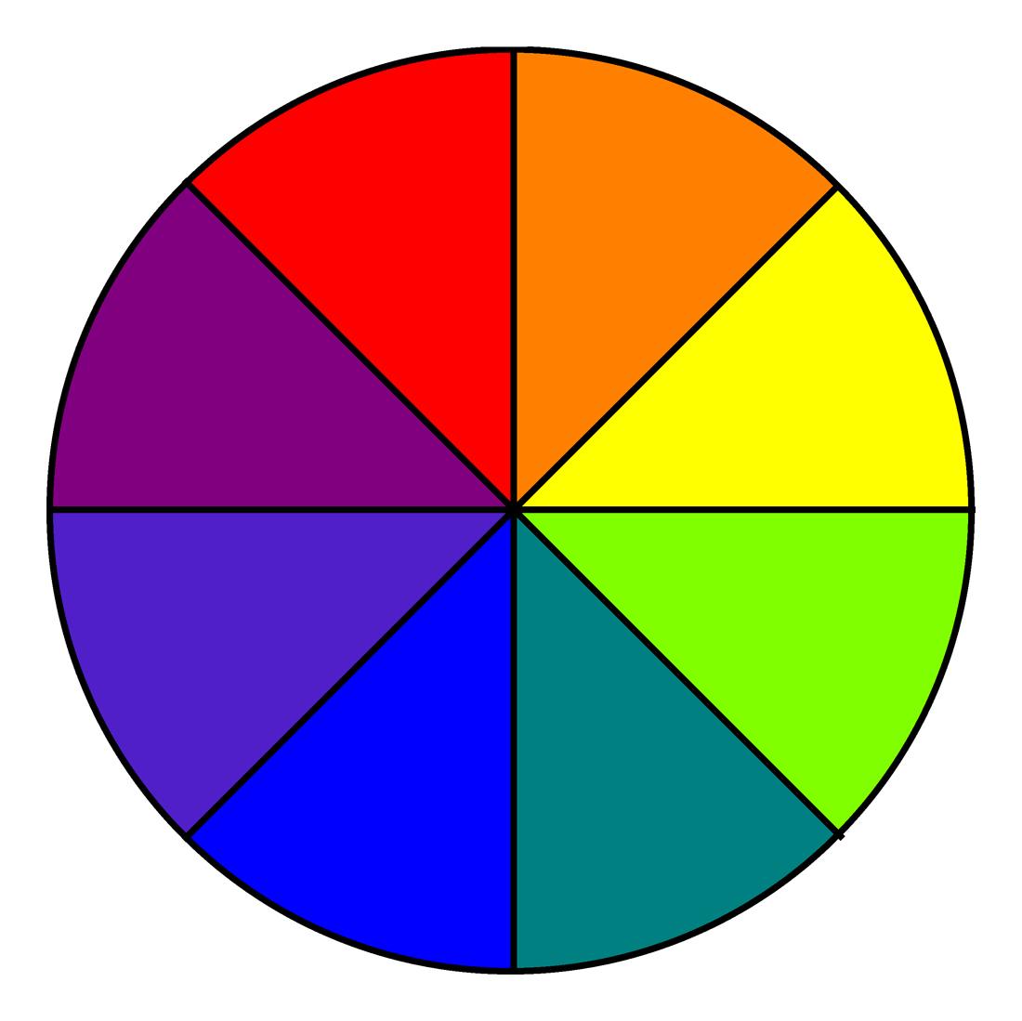
True Colors
Everyone has a color… What is yours?
By: Jackson Borowski

Slide 2
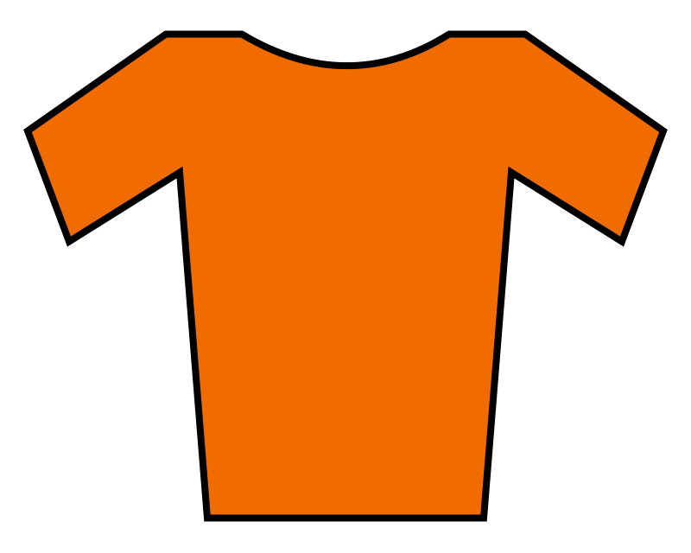
My Color is Orange!
I’m Jackson and I’m an orange
I am orange because I take risks, and I am very competitive, also a risk taker, and creative
Also I learn by doing things, I love to have fun, I like to have options and freedom, and I am good at negotiating
An example of why I am an orange is because
ME!

Slide 3
Blues…
Are imaginative, love honesty and integrity, love being social, and friendships are very important
An example of a blue is my sister, an example of this is when my sister didn’t get her friend in her class she got really upset for a long because she did not want to lose a relationship with that friend
Kindness, friendship, honesty

Slide 4
Greens…
Perform great when working independent, needs to be challenged, and seeks knowledge,
An example of a green is my friend… He is always the first one done with everything, from homework to tests he is almost always perfect
100% A+

Slide 5
Golds…
Like everything organized and perfect, love rules and structure, they encourage working in groups, they are also generous, and hard workers
An example of a gold is my friend, he really likes having rules so that he knows what to do and what not to do.(He NEVER breaks the rules) his desk was also very clean along with most of his room
Organized… Perfect

Slide 6
Orange…
Active, sports
Is also creative, a natural entertainer
Again an orange is very competitive, learns by doing things better than just seeing them, loves freedom, and a risk taker
An example of a blue is my brother… He is always imagining different things while he is out of this world playing with many different toys. (mostly stuffed animals) while how at the same time he is extremely competitive on playing everything from Hotweels races to mini sticks

